Slide 1

SCI 2000 Group 8 Presentation
Erik Huebner, Isham Behl, Muhammad Bilal Sheikh

Slide 2
Overall Research Idea
Primary Research Question:
How did COVID-19 impact the global economy?
Secondary Research Question:
How was the impact different for different industries?

Slide 3
Data Sources
Companies chosen from 10 countries:
Canada, United States, Japan, Brazil, Australia, France, Germany, Italy, Singapore, and United Kingdom
Companies chosen from 5 industries:
Finance/Banking, Tourism/Travel, Manufacturing, Food/Agriculture, Energy/Petroleum
Abbreviated as: Finance, Tourism, Manufacturing, Food, Energy

Slide 4
Data Sources – Financial Data
All data sourced from Yahoo Finance
Stock price data from January 2020 to March 2021
Annual Income Statements from 2018 to 2020
Quarterly Income Statements from Q2 2020 to Q1 2021

Slide 5
Data Sources – COVID Data
John Hopkins University CSSEGIS data repository for COVID-19
Daily case counts by Country
Daily death counts by Country

Slide 6
Data Collection
COVID-19 data was available for download as CSV
Stock price data from Yahoo Finance easily scrapable in table format
Annual financial statements required more advanced text parsing
Quarterly financial statements required RSelenium

Slide 7
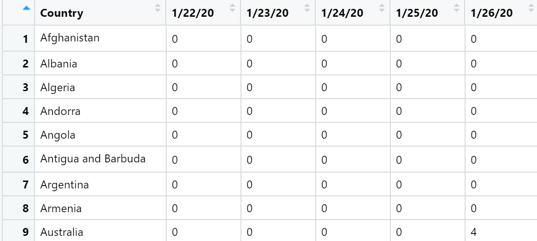
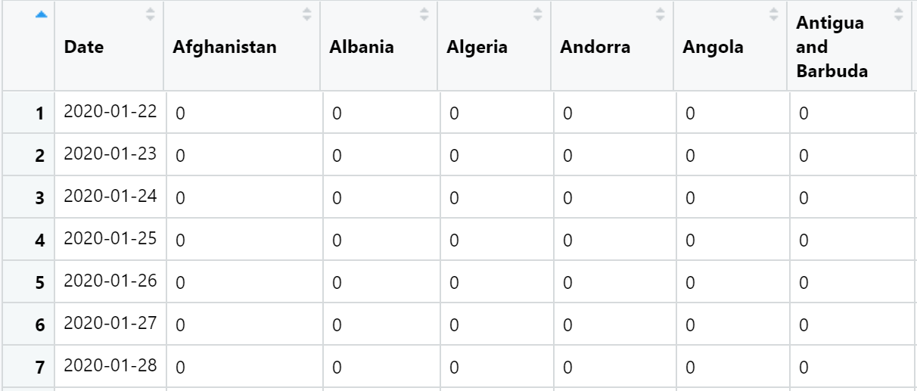
Data Cleaning/Preparation
COVID-19 Data Prep
Group data by country
Turn data into time series

Slide 8
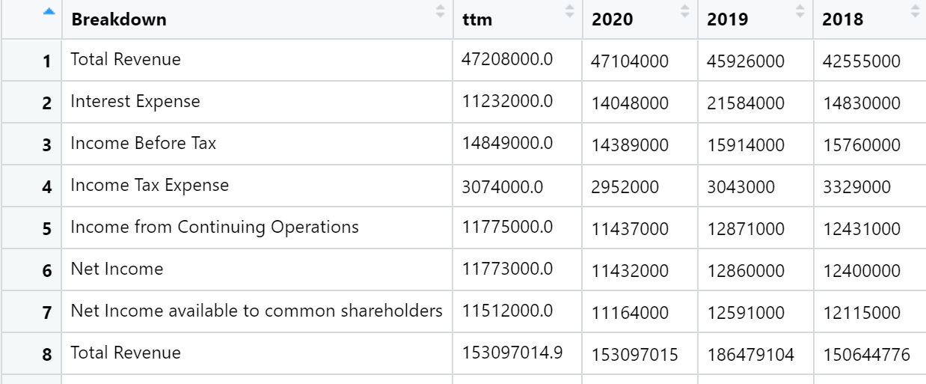
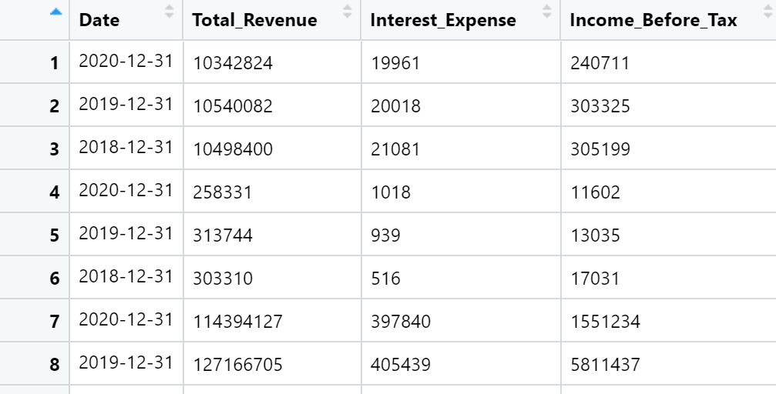
Data Cleaning/Preparation
Financial Data
Convert to CAD
Calculate return for stock prices
Turn income statements into time series
Join COVID-19 Data with Financial data
Joined on date and company
Also include global case/death counts for each row

Slide 9

Initial Analysis
Principal Component Analysis
We have many financial variables we can analyze quarterly income statements with
We’d like to find the few most important ones to focus our analysis
We’d also like to confirm that companies within our industries behave similarly in a financial sense

Slide 10
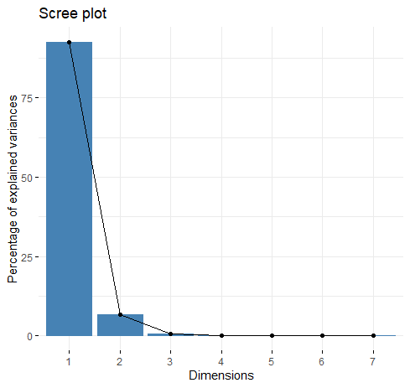
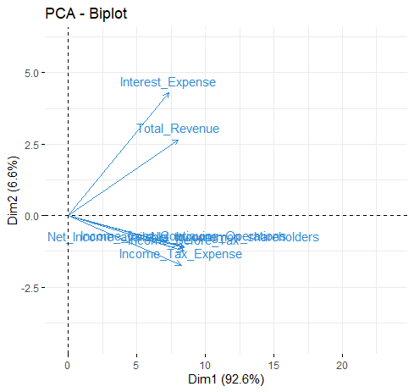
Principal Component Analysis Important Financial Variables

Slide 11
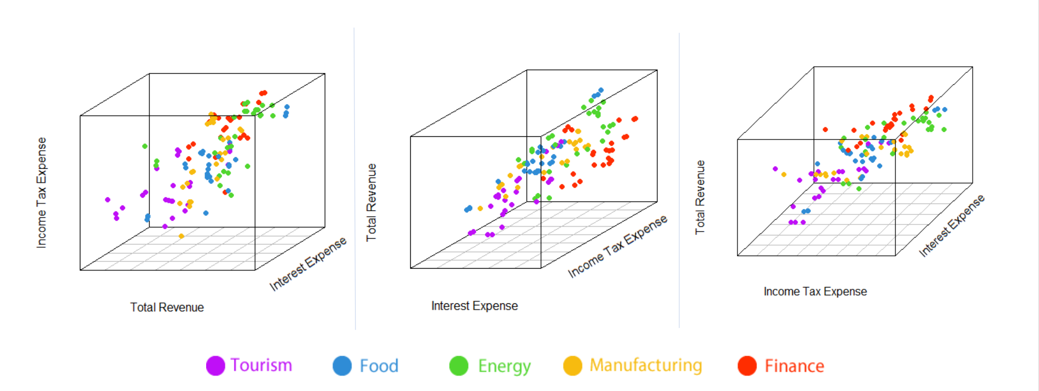
Principal Component Analysis Financial Similarity Within Industries

Slide 12
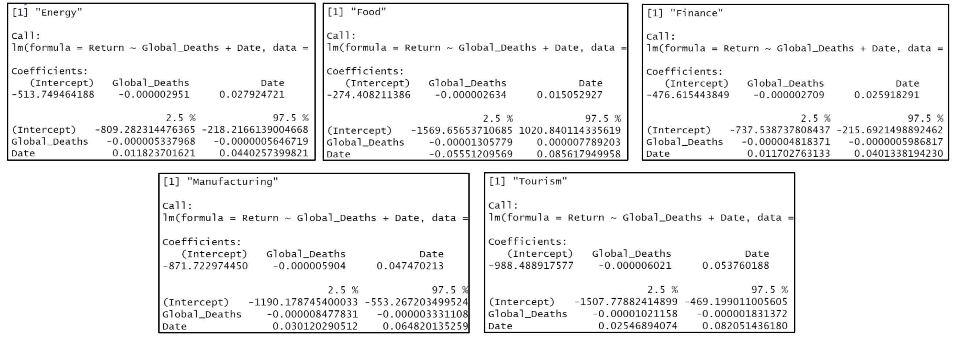
Further Analysis – Stock Prices

Slide 13
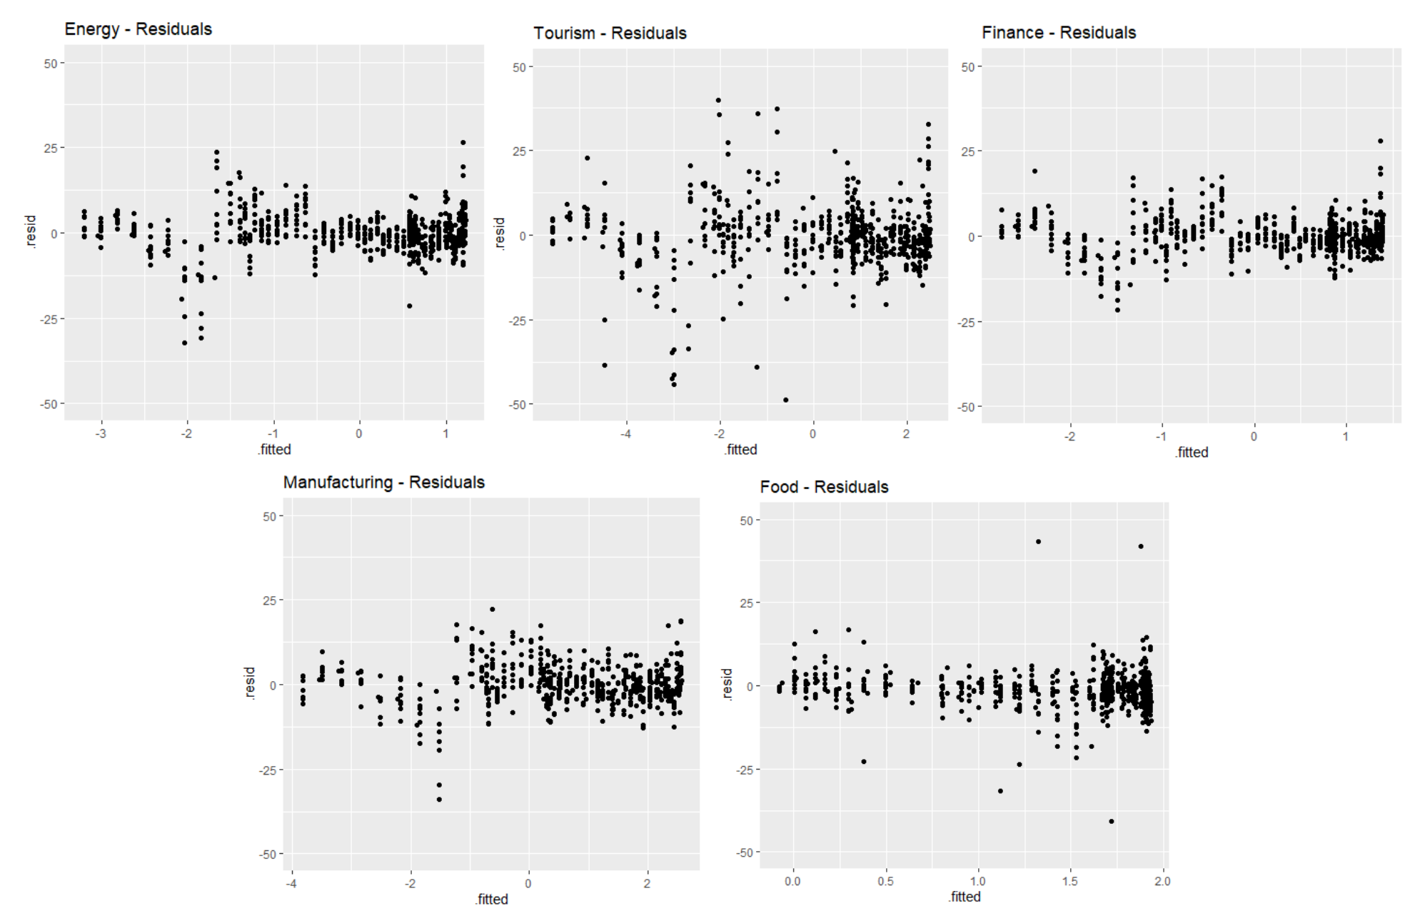
Further Analysis – Stock Prices

Slide 14
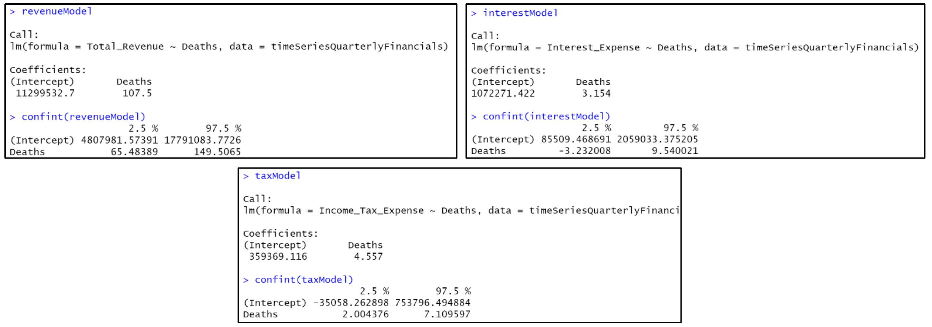
Further Analysis – Income Statements

Slide 15
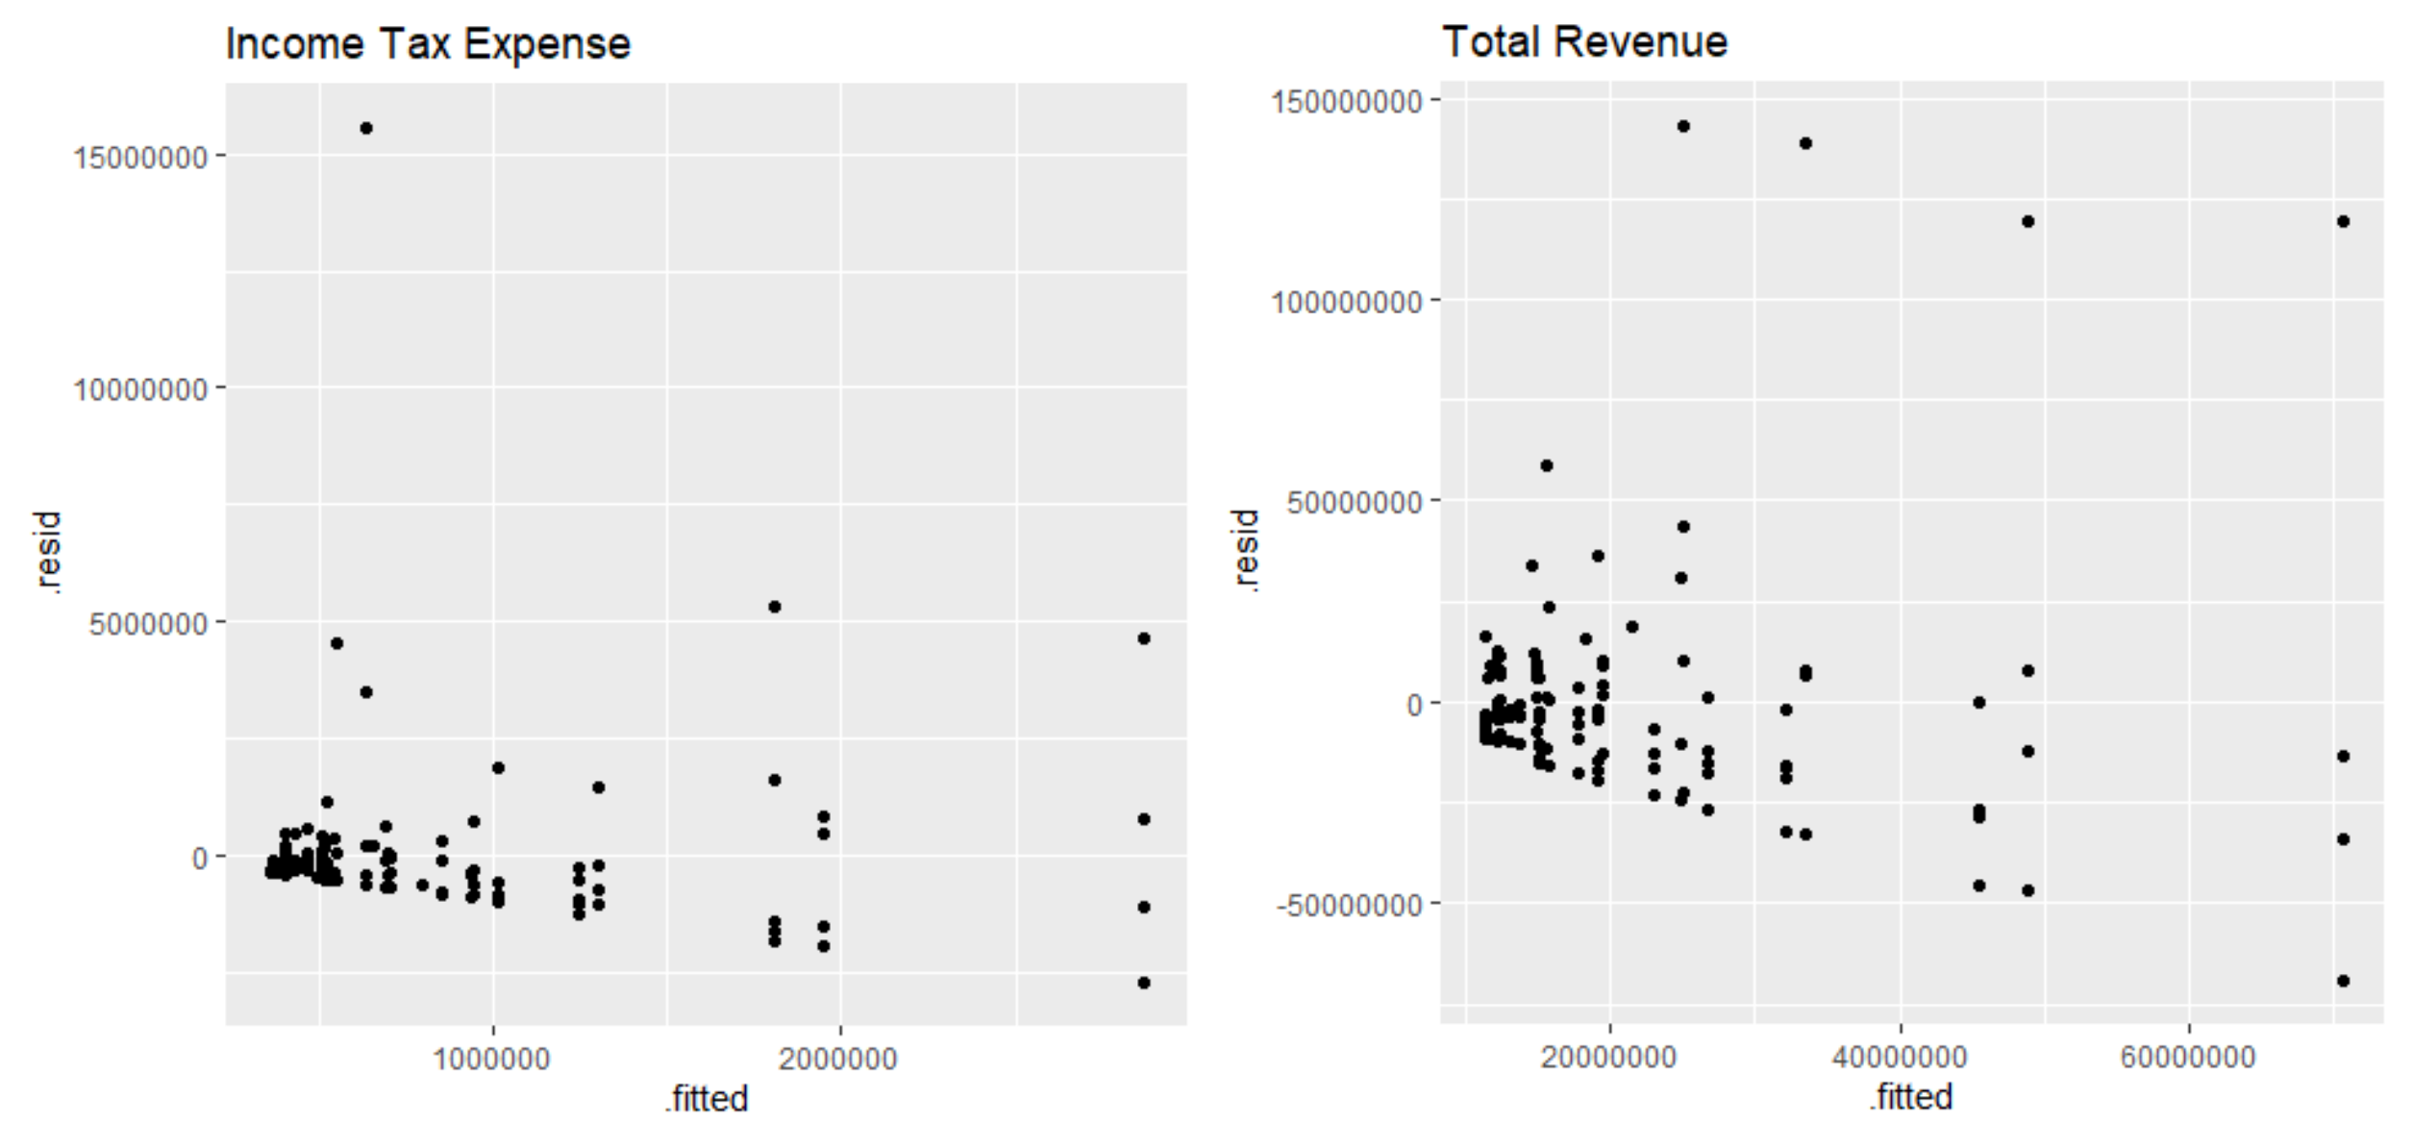
Further Analysis – Income Statements

Slide 16

Results?
They’re all either statistically insignificant or the assumptions of the linear regression model do not hold!

Slide 17
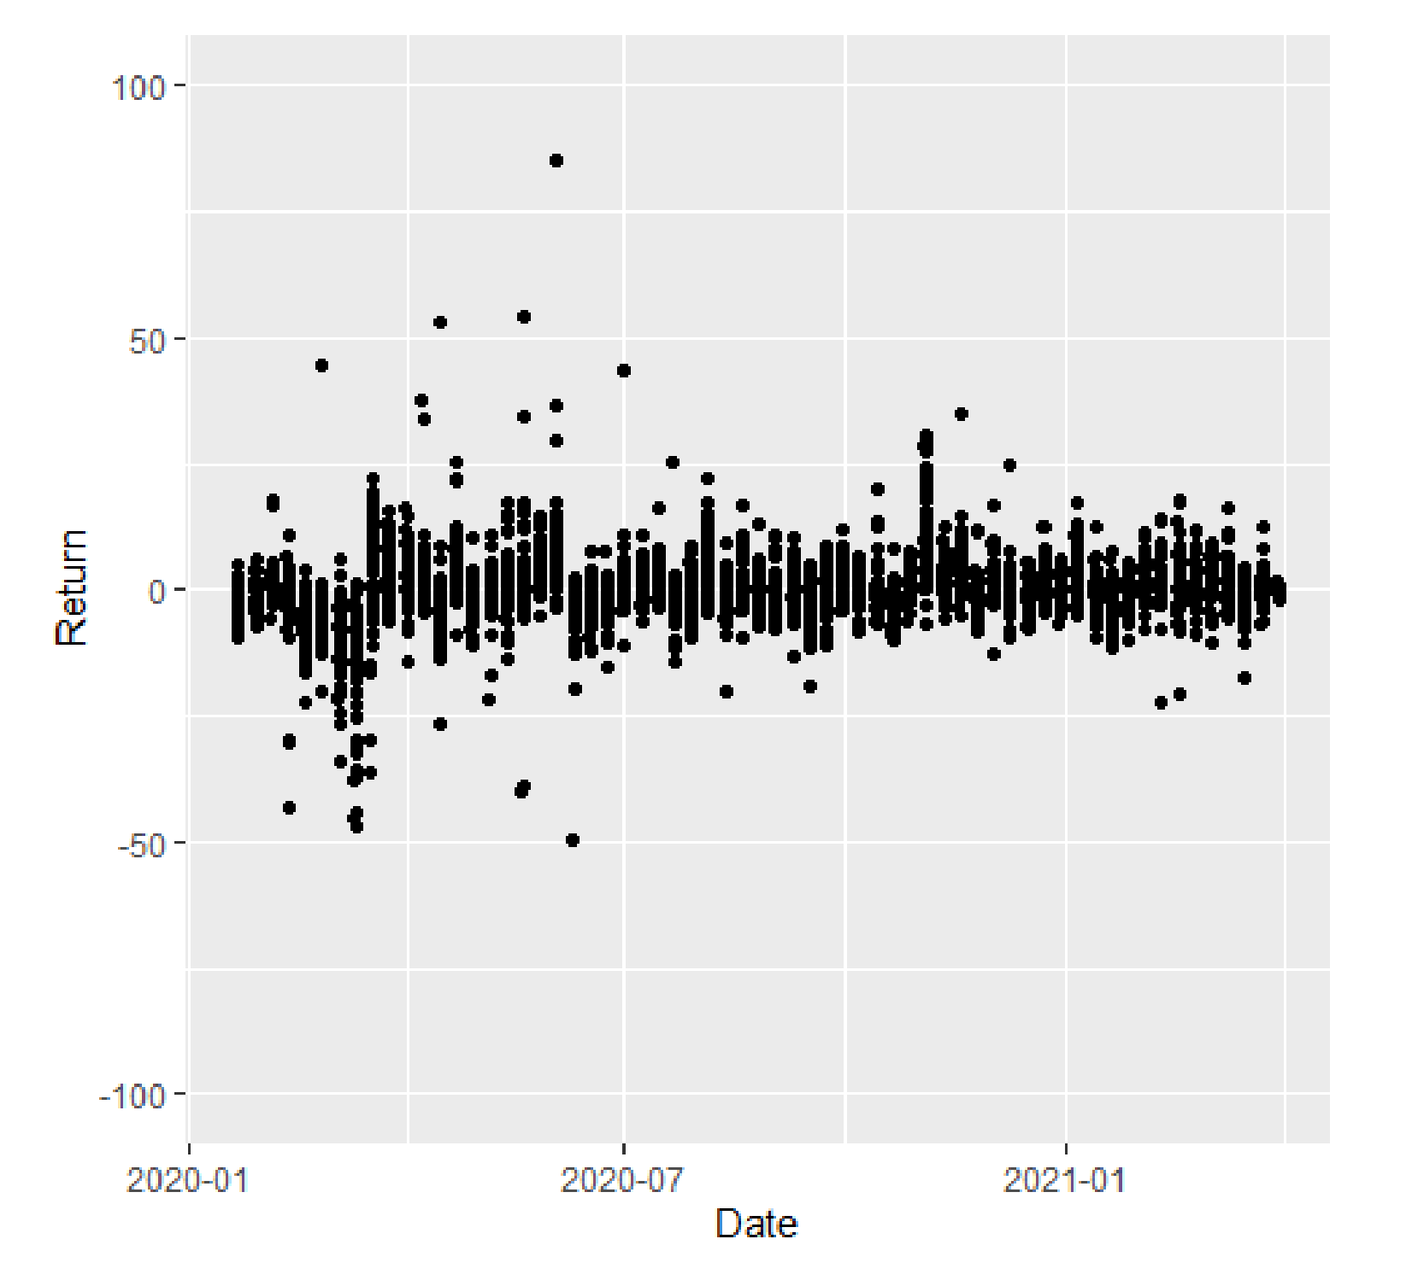
Conclusion
Our final conclusion was that expectation, not reality, was the main driver of global economic conditions

Slide 18
Considerations/Sources of Error
Small sample size
We only sampled 50 companies total, and 30% of the data had to be discarded
Sample bias
All companies chosen were large
Granularity
Companies only release financial statements every quarter

